Slide 1

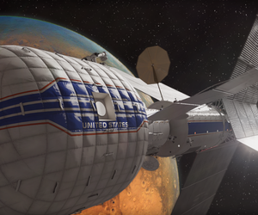
Your home in space

Slide 2
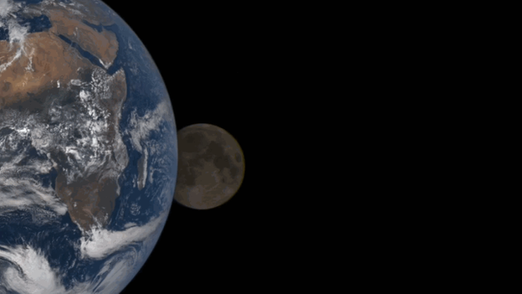
What if: your next home wasn’t on earth
Would you be able to survive?

Slide 3
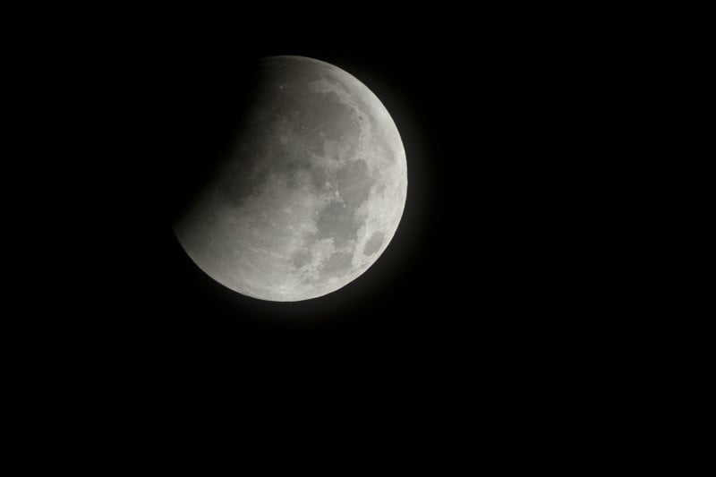
Would you be able to survive?
How?

Slide 4
How?
Would you be able to survive?

Slide 5
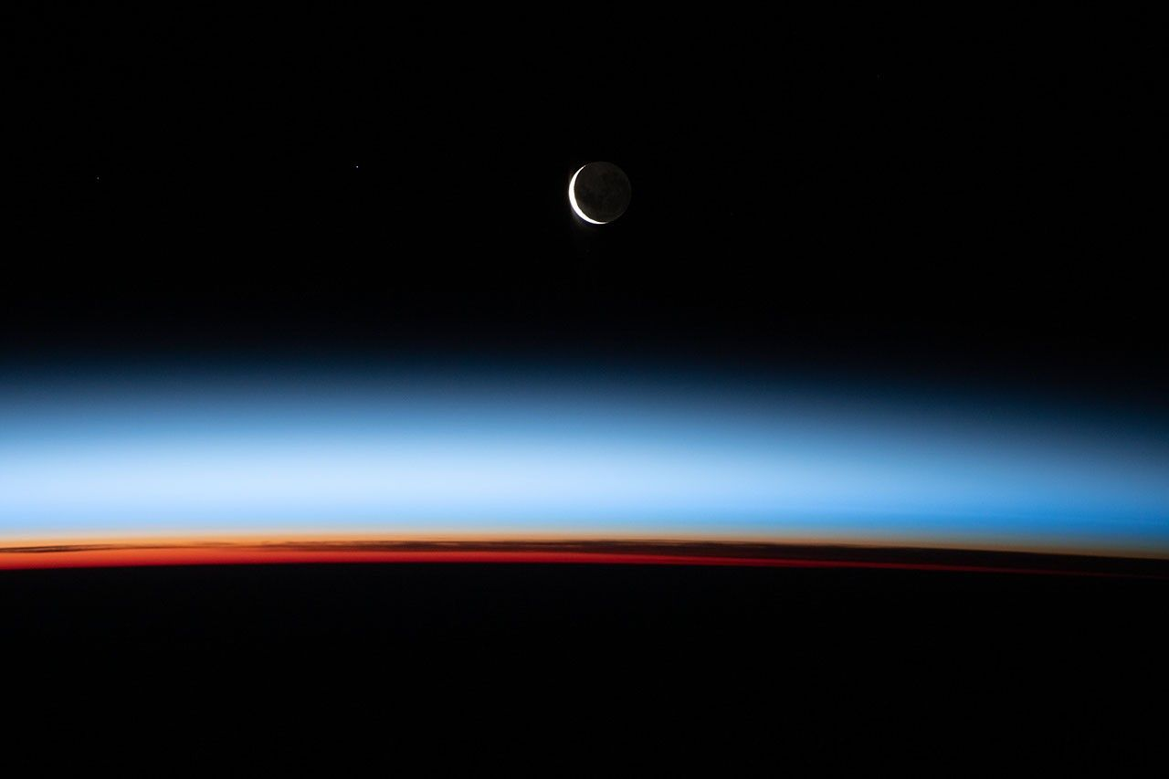
First of all you would need a house
And the house would need to have the necessaries to live

Slide 6
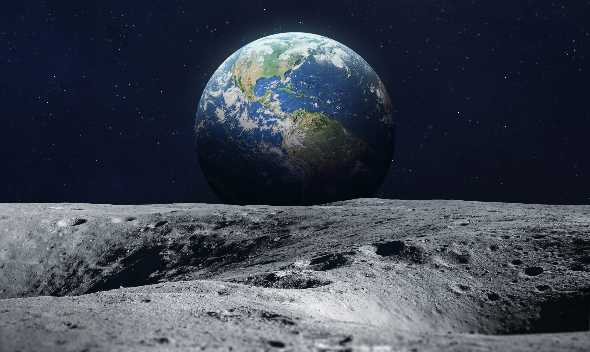

I don’t think that house would fit the moon

Slide 7

That’s better

Slide 8
But the real question is how would we be able to bring it on the moon?

Slide 9

What if the house would be in the rocket?
That would mean it should be like a chamber that would be into the rocket that would be left behind on the moon for others

Slide 10
It should be used by the astronauts even when they didn’t arrive so we wouldn’t use more space

Slide 11
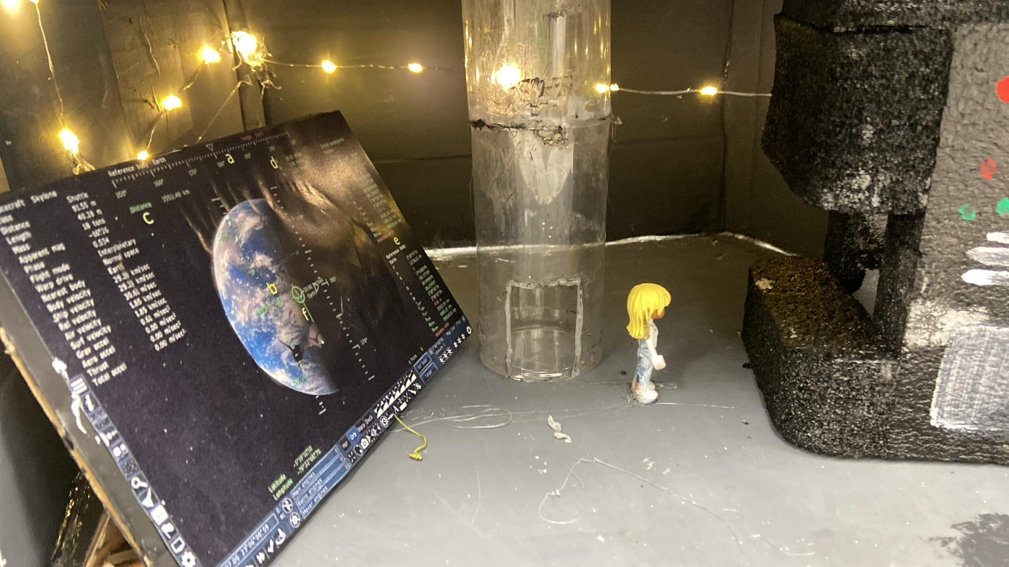
Now let’s build it!
We will start with the most important level
The ground
This level would have all the control of the racket and to talk to the humans back on earth

Slide 12
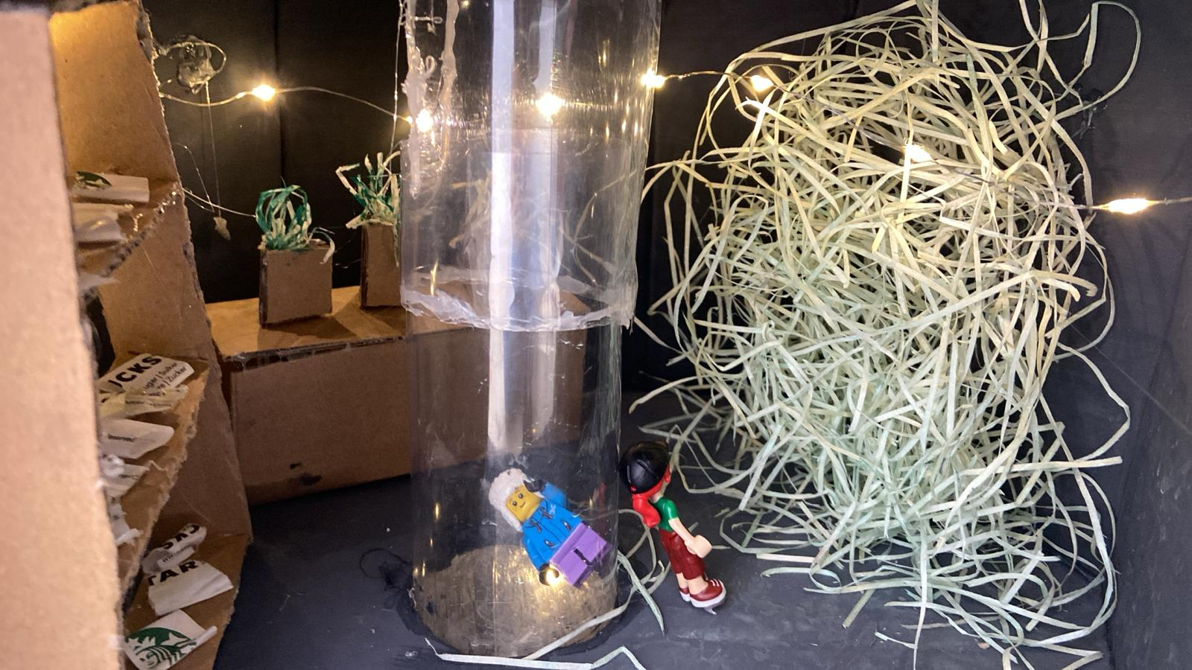
Here the astronaut's kitchen
This is the second Level

Slide 13
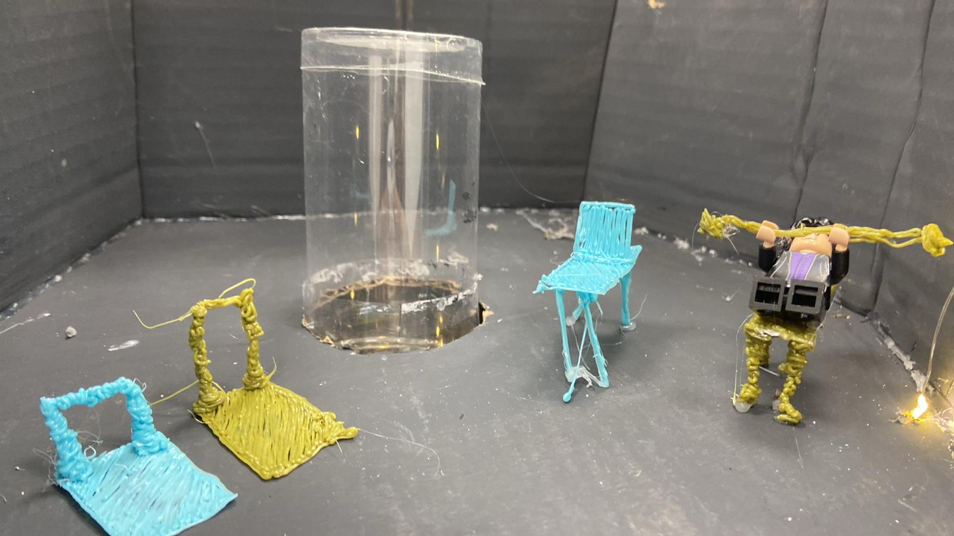
Here the astronaust will train for walking in low gravity
The highest level

Slide 14
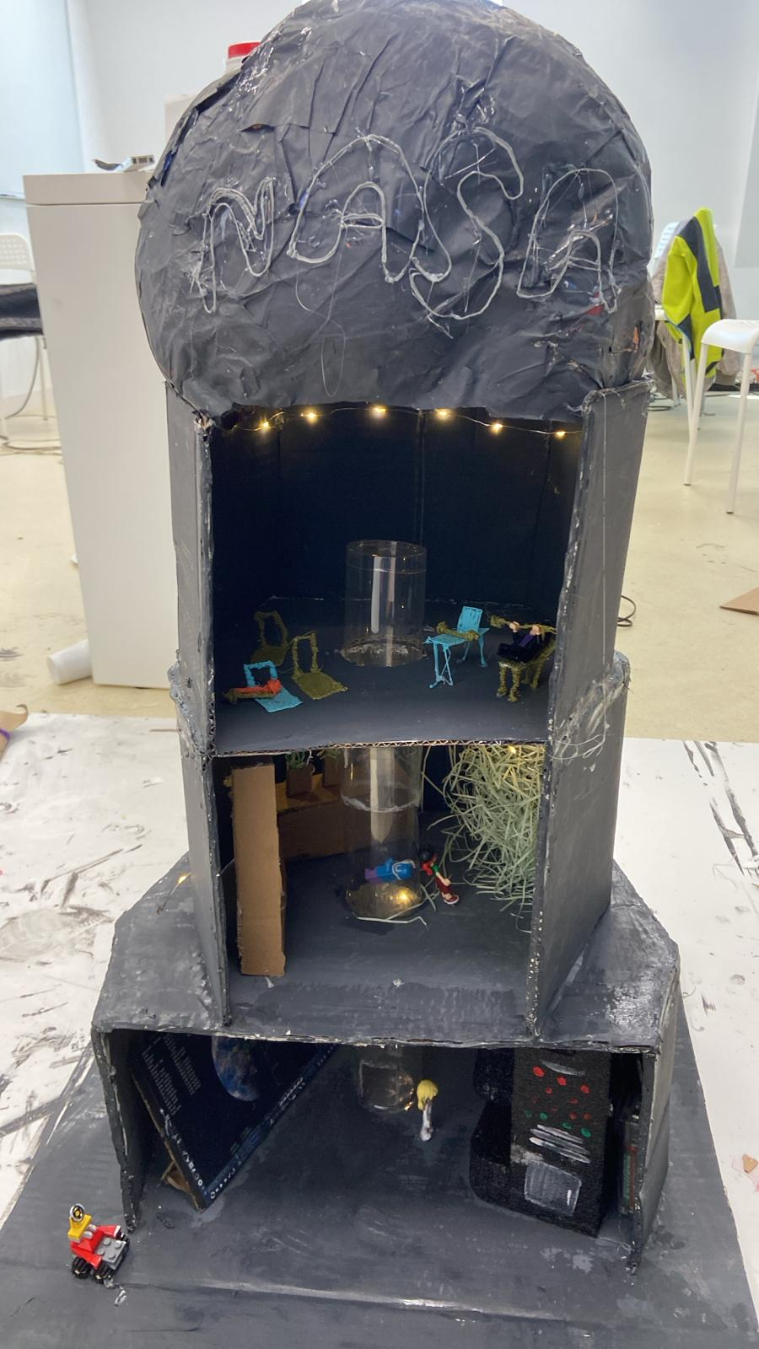
Let’s add them all together
That’s perfect!

Slide 15
Thank you for your attention!!

